Slide 1
What The Hack - Azure Arc enabled Servers Hack
Marcin Policht
Opsgility
Notes:
Welcome to Operationalizing Azure Kubernetes Service.
My name is [Speaker name].

Slide 2
Challenge Overview
Challenge 1 - Onboarding servers with Azure Arc
Challenge 2 - Policy for Azure Arc connected servers
Challenge 3 - Arc Value Add: Integrate Security Center
Challenge 4 - Arc Value Add: Enable Sentinel
Challenge 5 - Arc Value Add: Azure Lighthouse
You will work through the challenge in your own individual subscription that you activated via Azure Pass.
The last challenge will give you the opportunity to work with another member of your team to manage each others subscription using Azure Lighthouse

Slide 3
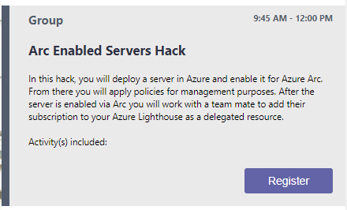
Step 1: Register
This step adds you to the team and your team's private channel.

Slide 4
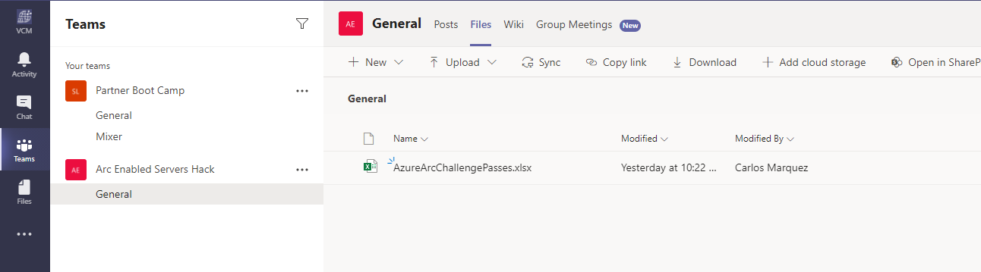
Step 2: Activate your Azure Pass
Open the Arc Enabled Servers Hack Team -> Open the Files Tab
Your Azure Pass voucher code is in the spreadsheet with your attendee login by it. Please ensure you only use your own code.
Follow the instructions carefully here: https://www.microsoftazurepass.com/
Issues with the code? IM @admin-2

Slide 5
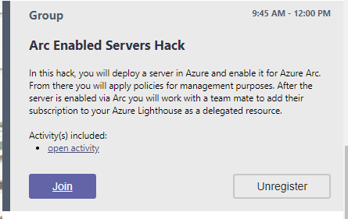
Step 3: Start the Challenge
1 = Open the Challenge Content
2 = Join your Team in a Meeting
Unregister removes you from your group so don’t click unless you want out.
1
2

Slide 6
Thank you.
Notes:
Thanks for attending Operationalizing Azure Kubernetes Service.
My name is [Speaker name].

